Slide 1
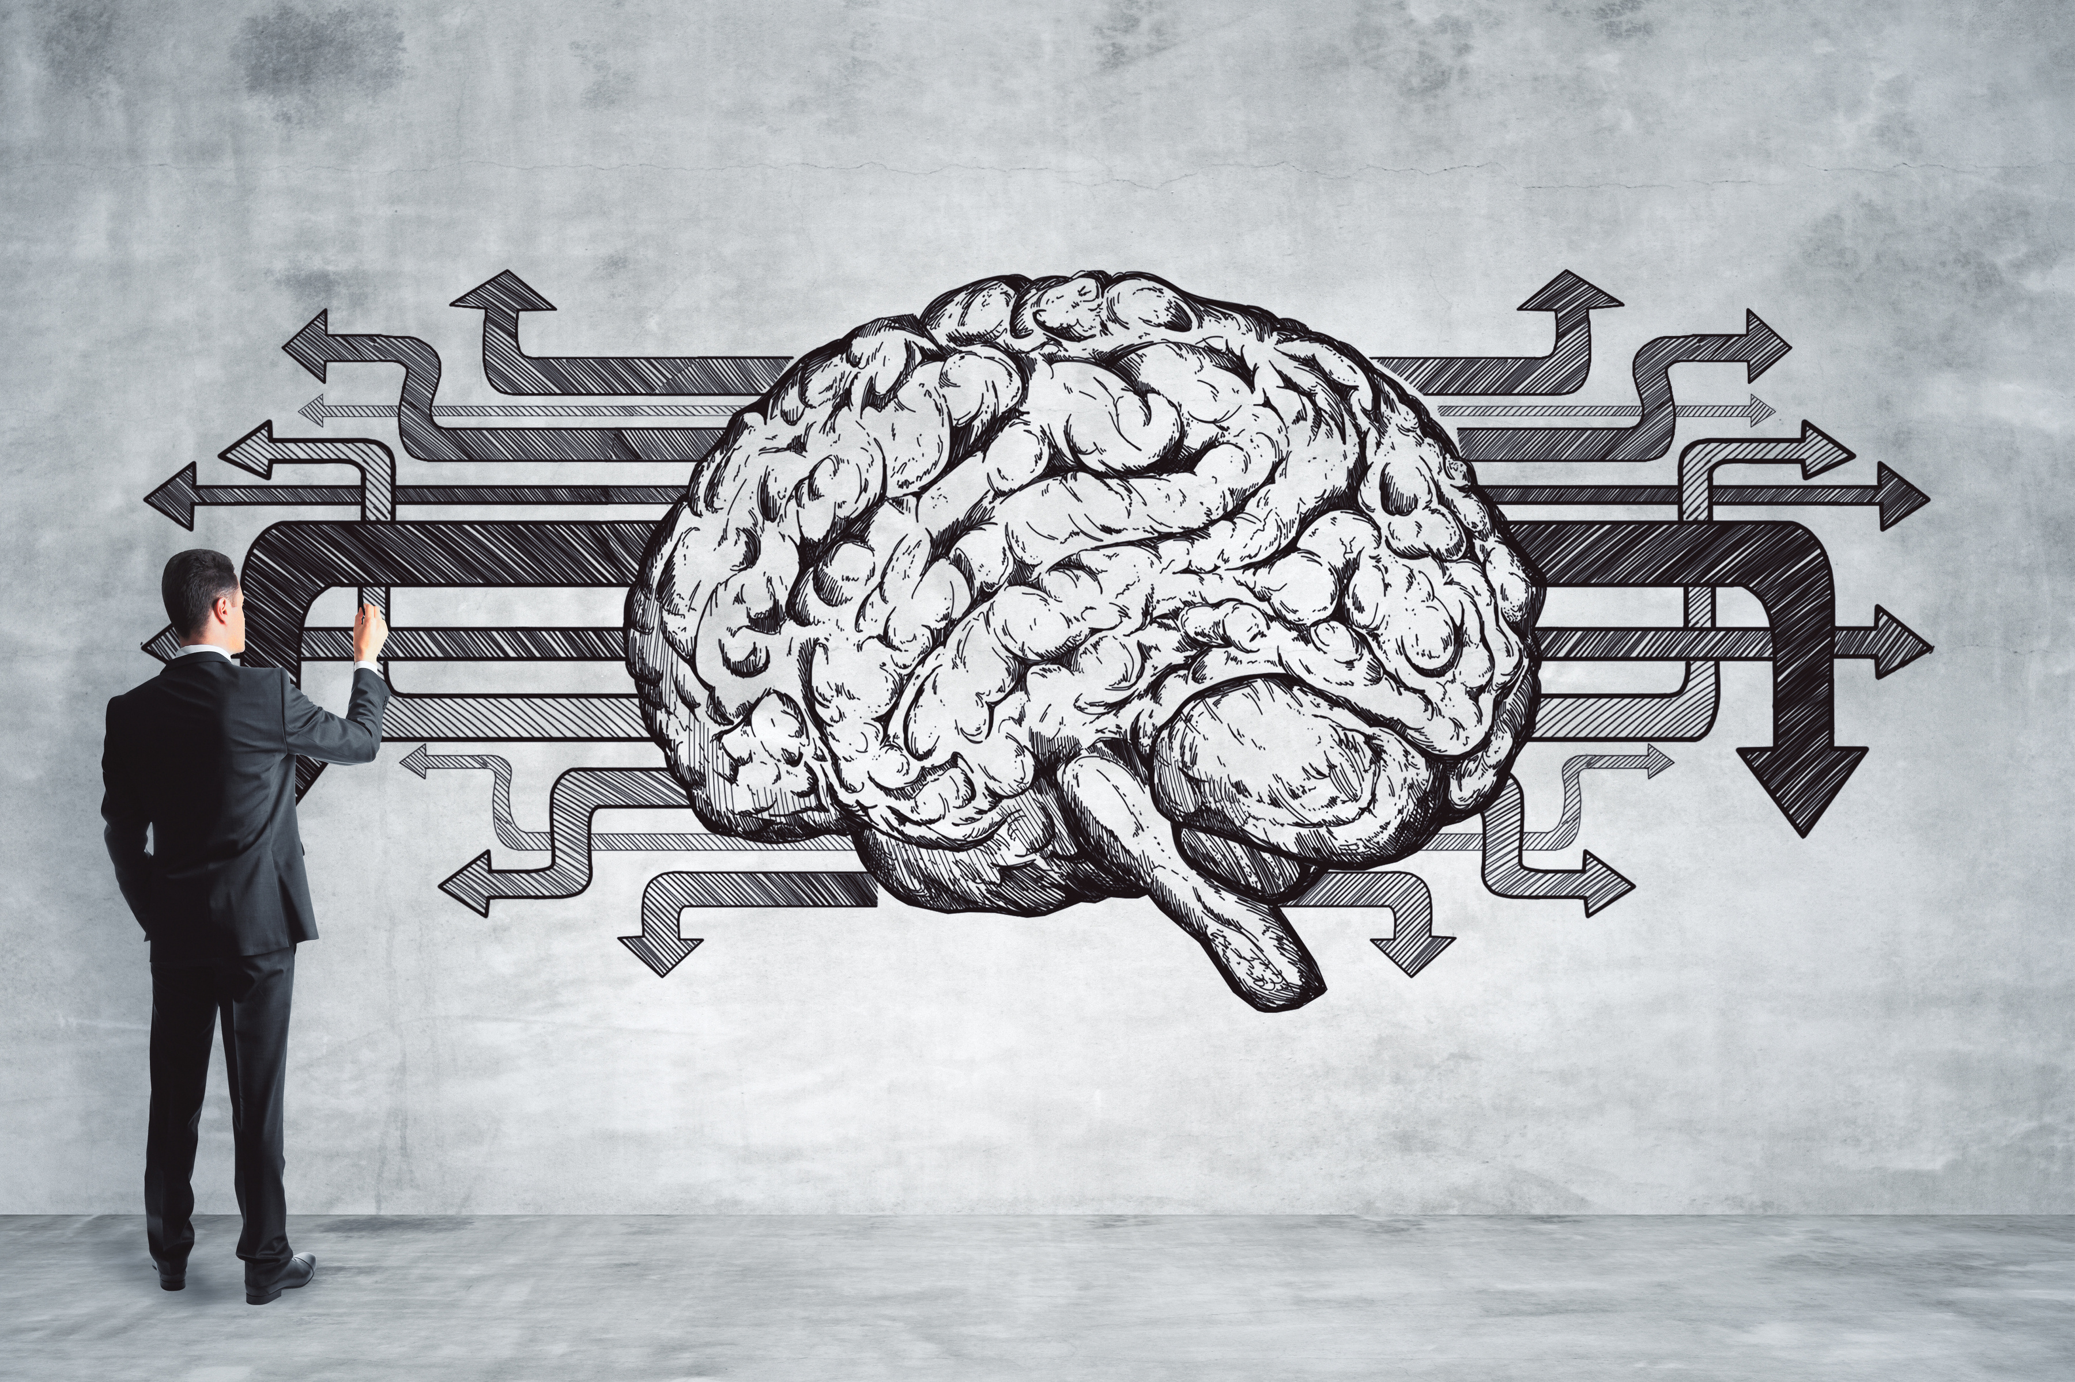

Defining:
Mindfulness, Metacognitions,
& Trauma tic Training
CHANGE YOUR BRAIN
CHANGE YOUR LIFE
(T-MOTHERFUCKER)

Slide 2
What tf is“Mindfulness “?
Effects of Mindfulness on Psychological Health:
A Review of Empirical Studies
“The elements of mindfulness, namely awareness and nonjudgmental acceptance of one's moment-to-moment experience, are regarded as potentially effective antidotes against common forms of psychological distress —rumination, anxiety, worry, fear, anger, and so on —
many of which involve the maladaptive tendencies to
avoid, suppress, or over-engage with one's distressing thoughts and emotions.”
(T-MOTHERFUCKER)

Slide 3
What tf is“Mindfulness “?
-“One of the most commonly cited definitions of mindfulness is the awareness that arises through “paying attention in a particular way: on purpose, in the present moment, and nonjudgmentally”
-“... the nonjudgmental observation of the ongoing stream
of internal and external stimuli as they arise”
(T-MOTHERFUCKER)

Slide 4
What tf is“Mindfulness “?
- Most follow the model of Bishop et al. (2004),
which proposed that mindfulness encompasses two components:
1) self-regulation of attention, and
2) adoption of a particular orientation towards one's experiences.”
(T-MOTHERFUCKER)

Slide 5
What tf is“Mindfulness “?
1) “Self-regulation of attention refers to non-elaborative observation and awareness of sensations, thoughts, or feelings from moment to moment. It requires both the ability to anchor one's attention on what is occurring, and the ability to intentionally switch attention from one aspect of the experience to another.”
(T-MOTHERFUCKER)

Slide 6
What tf is“Mindfulness “?
2) “Orientation to experience concerns the kind of attitude that one holds towards one's experience, specifically an attitude of curiosity, openness, and acceptance. It is worth noting that “acceptance” in the context of mindfulness should not be equated with passivity or resignation.”
(T-MOTHERFUCKER)

Slide 7
*My note:
Acceptance is not: learned helplessness, giving up control, toxic positivity, gratitude or appreciation for negative events.
It IS neutral observation of what is/has happened. This is required before the brain can engage with / formulate a conscious response to reality.
(T-MOTHERFUCKER)

Slide 8
Mindfulness & Meta-Cognition.
Meta-Cognition: Thinking about thinking.
Having awareness of internal events (thoughts, feelings, beliefs, values) with neutral observation.
Thus, proving that YOU ARE NOT YOUR BRAIN
– or how are you separately observing that fucker?
Your consciousness is more powerful-than, and distinct-from, your thoughts or feelings.
(T-MOTHERFUCKER)

Slide 9
Mindfulness & Meta-Cognition.
Meta Cognition becomes easier with practice, like a muscle you’re building.
It incorporates Type II processing (reflection, critical thinking, consequence forecasting, recalibrating behaviors) – ideally, with time, this is accomplished in real time, in situ, rather than after the moment has passed.
(T-MOTHERFUCKER)

Slide 10
Mindfulness & Meta-Cognition.
Through Meta Cognitions & Mindfulness, we identify our “old training,” recontextualize the stories / lessons our brains have accepted in the past, and design new behavioral plans based on modern reality rather than repeating maladaptive, reactive, automatic behaviors.
(T-MOTHERFUCKER)

Slide 11
“Traumatic Training”
“Training”: the ways our brains are conditioned through plain ole Punishment and Reward via authority figures.
-Punishment: anything that decreases
occurrence of a behavior in the future.
-Reinforcement (Reward): anything that increases occurrence of a behavior in the future.
*NEGATIVE REINFORCEMENT IS NOT PUNISHMENT,
it is the removal of an unpleasant stimulus which provides relief,
thus reinforcing a behavior through negation of a stimulus.
(T-MOTHERFUCKER)

Slide 12
“Traumatic Training”
Ways we can create lifelong narratives that become automatic, rigid, behavioral patterns:
1) Accurate learning in real time.
EX: You express emotion -> Immediately, Dad screams, Mom slaps, they ignore you, criticize you, threaten to “give you a reason to cry,” etc. The brain realizes emotional expression leads to punishment.
(T-MOTHERFUCKER)

Slide 13
“Traumatic Training”
Ways we can create lifelong narratives that become automatic, rigid, behavioral patterns:
2) Superstitious & self-validating connection making.
EX: You express emotion -> you don’t hear back from a friend immediately, OR, a month later they seem to pull away. The brain makes inaccurate connection which confirms that emotional expression leads to punishment.
(T-MOTHERFUCKER)

Slide 14
“Traumatic Training”
Ways we can create lifelong narratives that become automatic, rigid, behavioral patterns:
3) Self-defensive, self-confirming, or forced-logic explanation.
EX: You expressed emotion at some point -> your friend stopped being your friend at some point. The brain needs an explanation to stop obsessing about loss. It decides emotional expression at some time must have led to eventual punishment.
(Fitting new experience into prior framework of understanding, perhaps overlooking more obvious / self-accountable causes for the friendship dissolution)
(T-MOTHERFUCKER)

Slide 15
How lessons become automatized beliefs & behaviors
Each instance of “similar enough” events that can be patched together confirms the correctness of the original training. The initial event becomes a narrative that can be applied to many situations, creating a cohesive story that stretches across autobiographical memory.
* This repeat exposure to a shitty lesson from childhood is likely to happen again, because our early friendships / partnerships often mirror our parental (and other unhealed) relationships.
(T-MOTHERFUCKER)

Slide 16
How lessons become automatized beliefs & behaviors
At the same time, this story that has been “proven with repeat evidence” becomes a set of instructions for behavior.
Due to repeat exposure and/or extremely dire expected consequences, an automatic reaction to the experience of having emotions is created, mostly unconsciously.
(T-MOTHERFUCKER)

Slide 17
How to rewire trained beahviors
This pattern will not be broken, and future events will not be neutrally observed or consciously responded to until Mindfulness/ Meta Cognition is used in order to:
EX: 1) Notice emotions that are happening
2) Notice thoughts or emotions about these emotional happenings
3) Critically think about the current reality of thought/emotion, via placing the learned reaction in life history
(When was this originally “trained” into me? And why?)
4) Make corrective, conscious, self-oriented decisions about how to behave, rather than following immediate impulse.
(T-MOTHERFUCKER)

Slide 18
How to rewire trained beahviors
This re-understanding (recontextualizing) of lessons from the past can be complicated due to:
-The multiplicitious influences that have scarred our neurons with time. Each experience, appearing more “real” than the last due to the growing pile of “evidence.” (see: Traumatic Training slides)
-The need for a “childlike outlook” on previous events.
The “Punishment” received back then might not appear to be very significant from your adult viewpoint; however, we are 100% dependent on our superiors for survival as children. That means, a single instance of being ignored / punished can leave a huge impression on your young mind as a dire punishment, sealing in the lesson that emotions = abandonment = death, for example.
(T-MOTHERFUCKER)

Slide 19
Major takeaways:
We need to learn to pause, name our internal conditions accurately, and recontextualize our “accepted lessons”
– or we’re doomed to repeat them indefinitely as
“Fucked Up Core Beliefs” and automatic instructional programs that shape our lives (and unfulfilling / traumatizing relationship experiences).
(T-MOTHERFUCKER)

Slide 20
Major takeaways:
Perhaps, at the time of initial learning, we were “trained” accurately to survive that situation.
However, over time, the original lesson becomes over-generalized to every situation and stops being questioned or reconsidered. At this point, the behavior becomes automatic - it becomes a trauma-derived reaction rather than a conscious decision. Through rigid repetition without the consciousness to re-predict consequences / recalibrate behavior, it stops being adaptable and starts to be a problematic behavior that sabotages the individual’s attempts at living their own life.
(T-MOTHERFUCKER)

Slide 21
Major takeaways:
Thus, we need to practice this stupid term:
“Mindfulness”
As a means of neutral self- and situational- observation that questions what we previously accepted as unquestionable reality...
.. So we can behave in line with present day reality,
rather than accidentally living in the past, trapped in a traumatic loop that defines our lifetime.
(T-MOTHERFUCKER)

Slide 22
Sidenotes:
Common reactions to emotions that we don’t feel permitted to have/voice:
Freezing, suppressing or repressing emotion, transmuting ‘dangerous’ emotion into more comfortable emotion (secondary emotions), lashing out, isolating/withdrawing, self-berating before someone else does it for you,
eating, sleeping, other off-base need fulfillment
(T-MOTHERFUCKER)

Slide 23
Sidenotes:
Why IS it SO common that humans learn emotions are unsafe?
Our families and early relationship partners usually lack emotional intelligence and emotional management skills. Therefore, it’s threatening for us to have emotions because:
1) they don’t understand them, even within themselves, 2) there’s some chance that they will have emotions in response to our emotions – which they do not know how to handle within themselves, making our feelings threatening to them,
3) emotions delay/disrupt our abilities to serve our authority figures, codependents, and bosses, 4) if we develop emotional recognition we might start to believe our own experience is valid and accurately identify their abuse.
Then, this message is repeated throughout our societal / social experience. (Don’t cry at school, work, in public, on the internet, etc.)
(T-MOTHERFUCKER)

Slide 24
Sidenotes:
Why call it “training”?
Because our authority figures use their social and biological sway to teach us to be less burdensome / inconvenient for them, via simple Punishment and Reward setups.
Just like we do with house pets.
*Authority figures can include extended family, older siblings, peers with influence, etc. as much as teachers, bosses, parents. A layered examination of “similar feeling events” can help identify the many times our brains have created / validated the maladaptive lesson from “authority.”
(T-MOTHERFUCKER)

